Slide 1
June 13, 2023 Parent & Student Information Session

Slide 2
Agenda
Player Expectations
Conduct
Chemical Health
Commitment
Academic Support
Equipment Needs
Administrative Needs
Communications
Playing Time
Schedule
Fundraisers
Key Dates
Questions

Slide 3
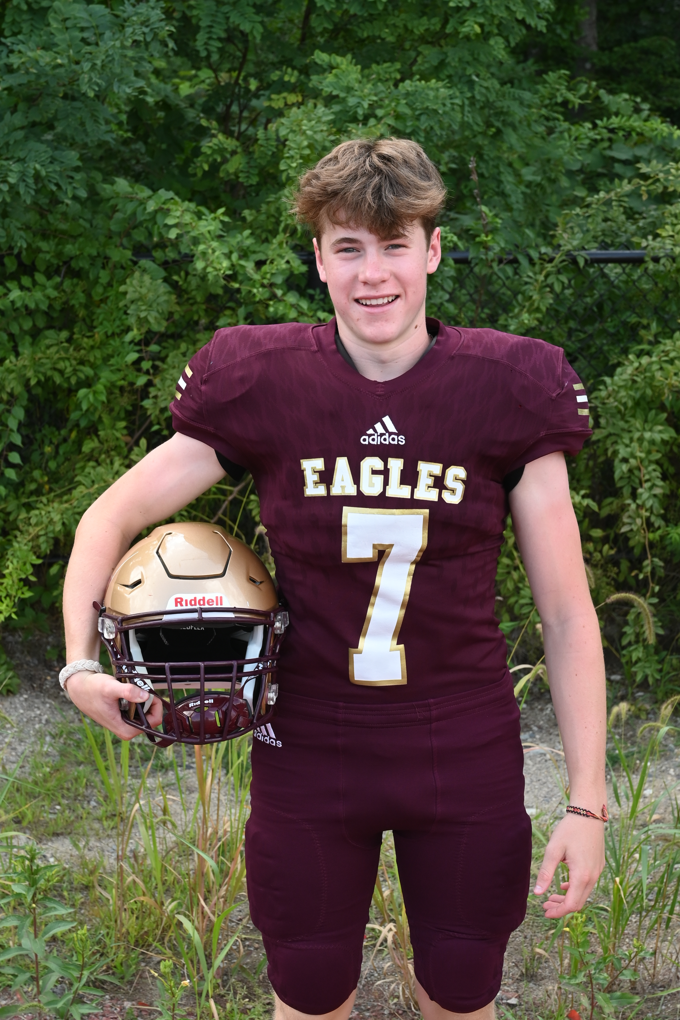
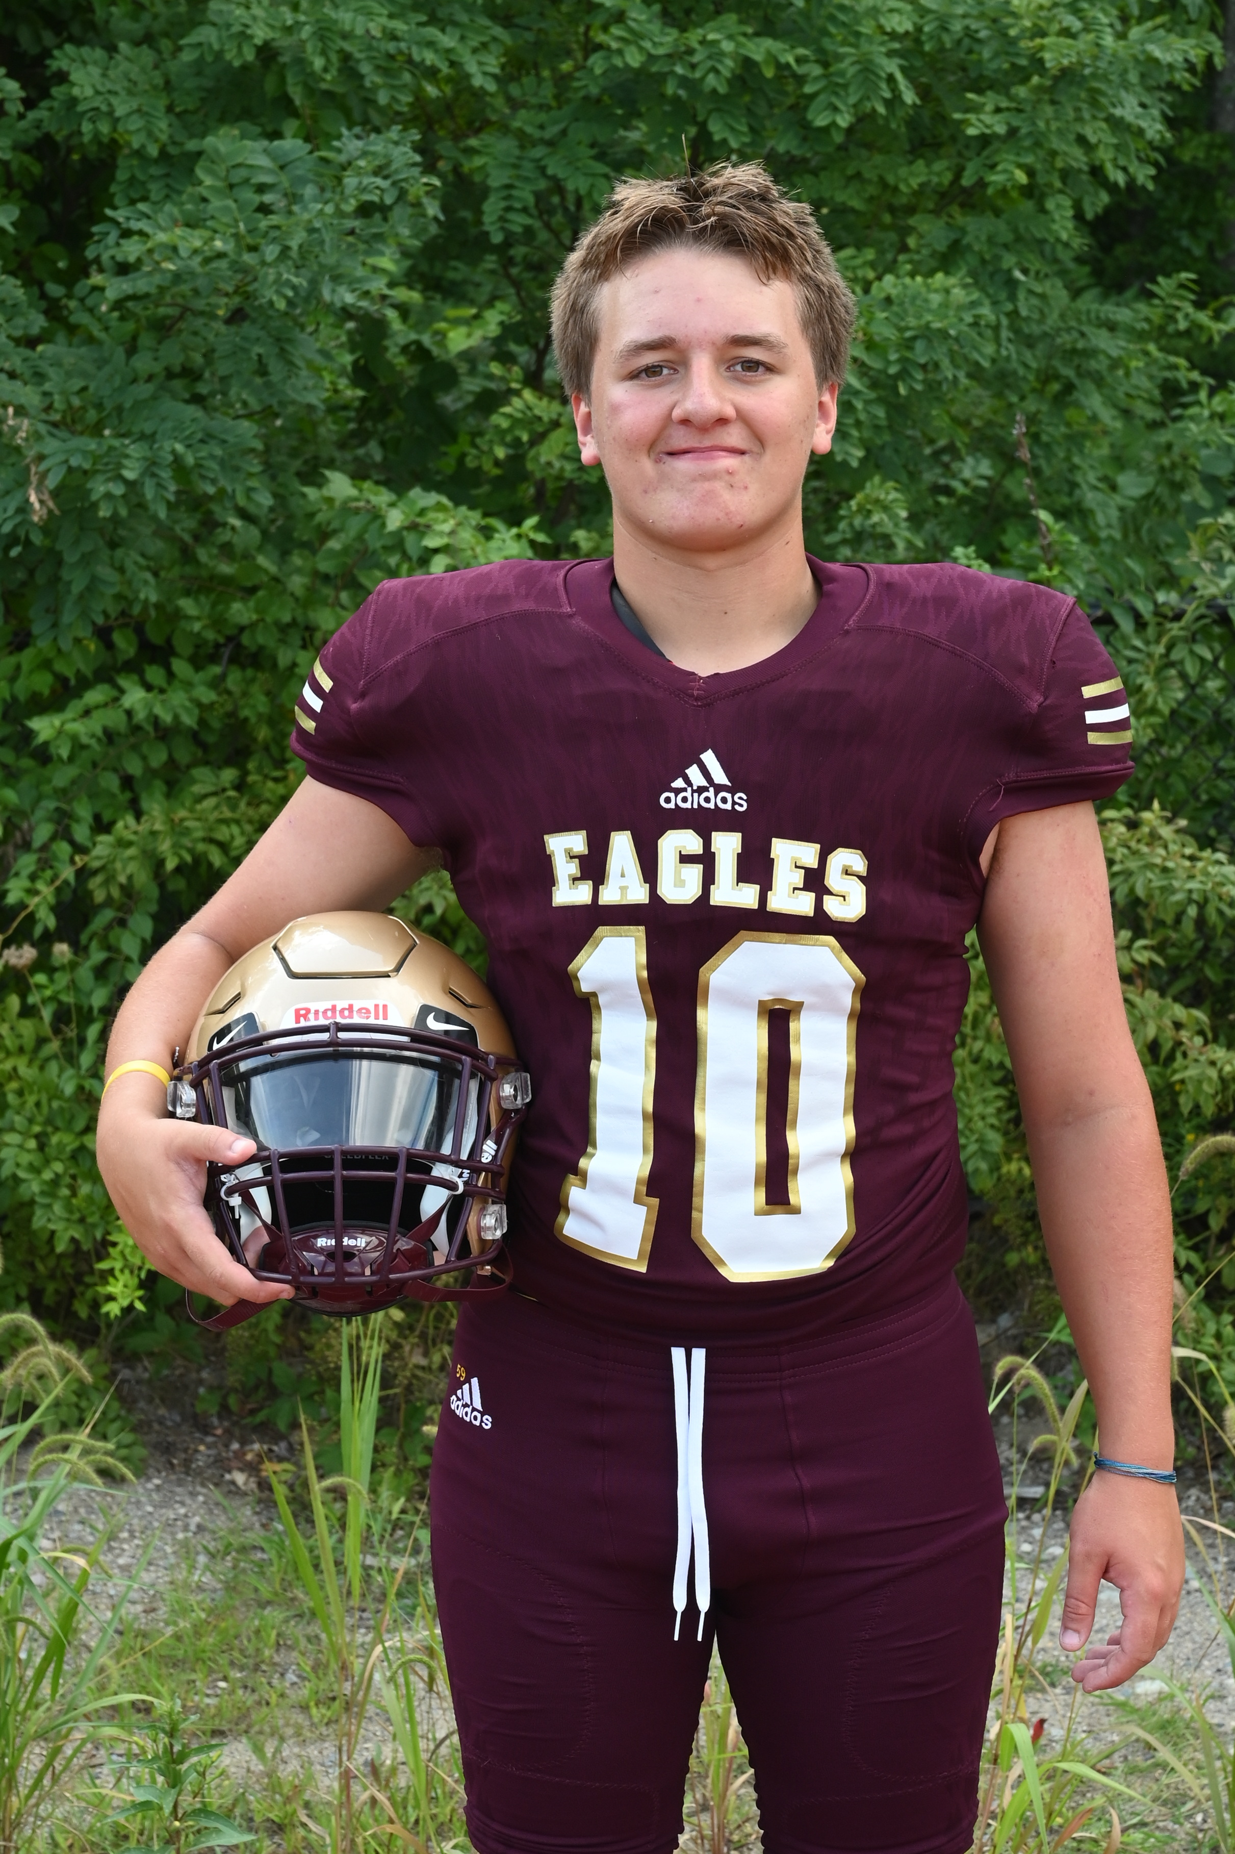
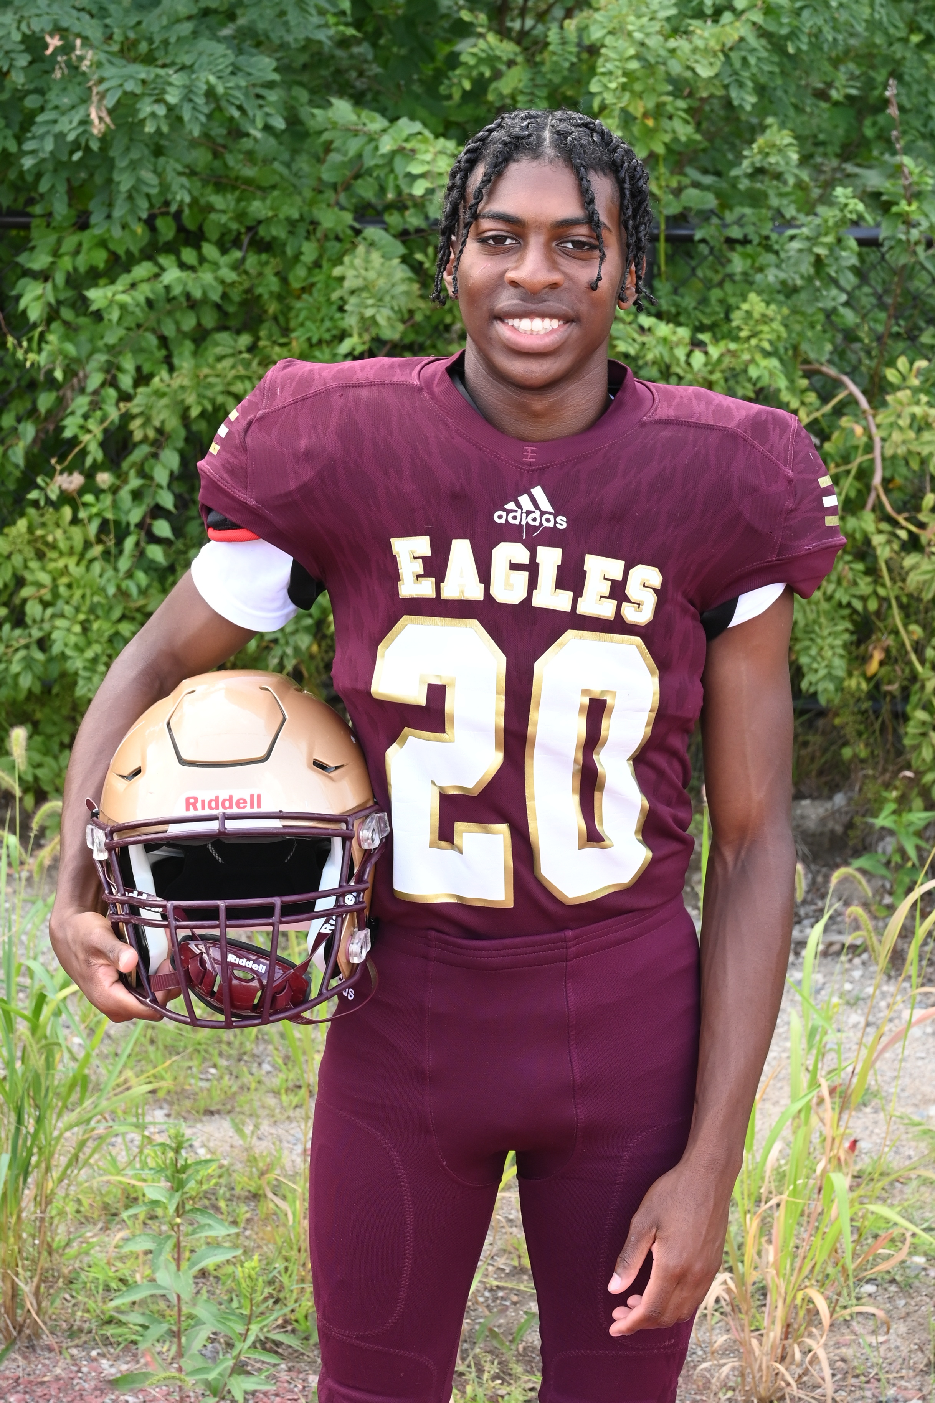
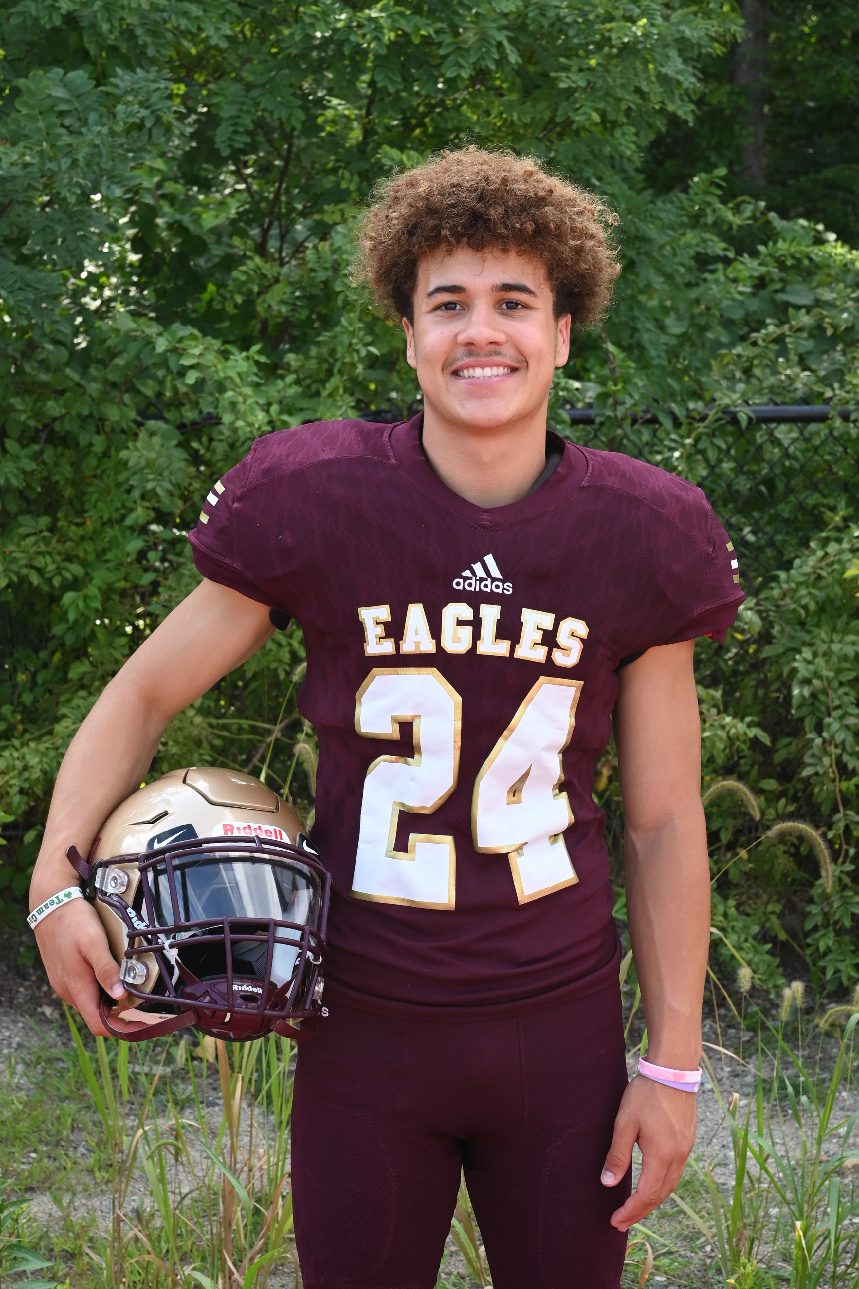
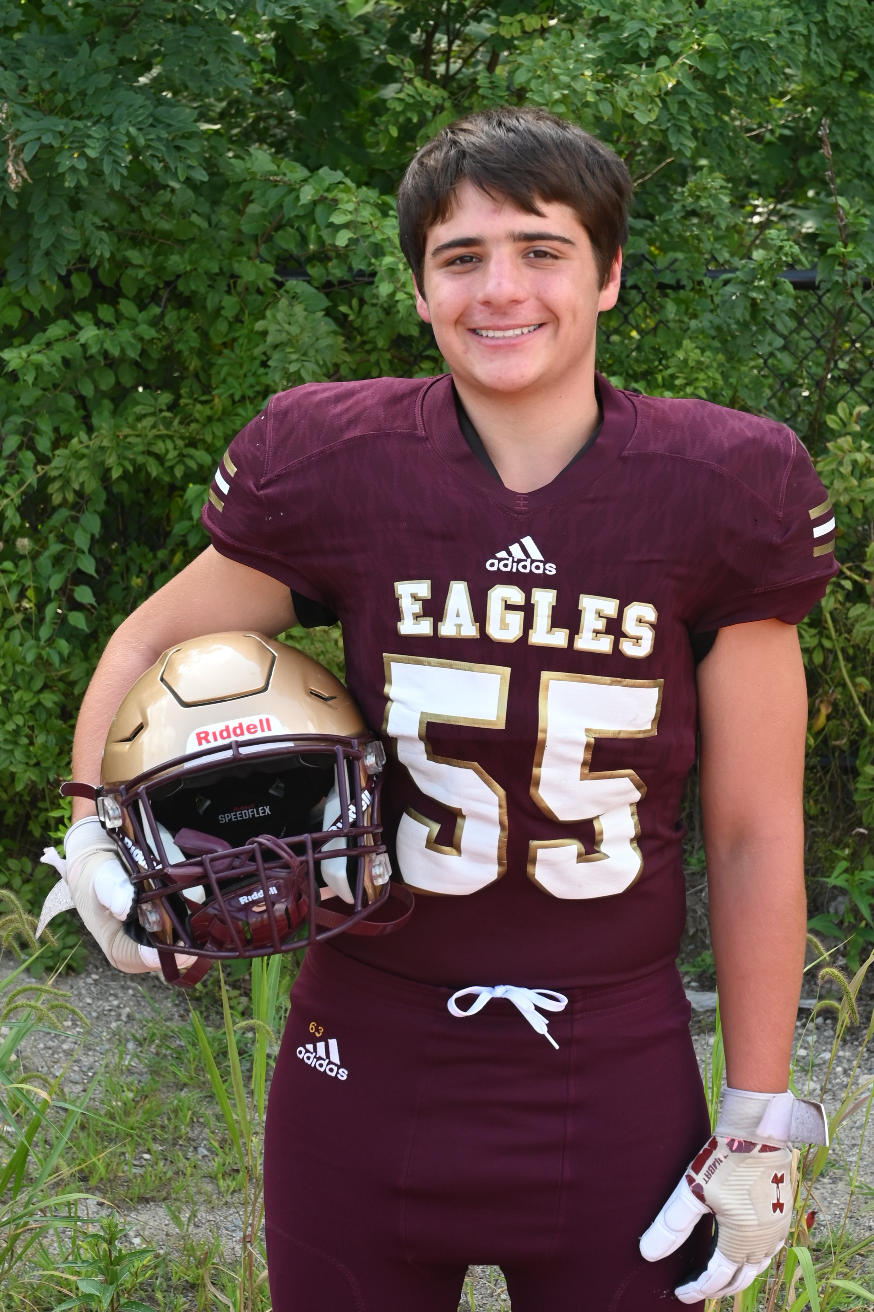
Gabe Korn
Zach Carmody
Liam Conway
Elijah Wisdom
Duncan Seaman Jr.
Jake Loomis

Slide 4
Player Expectations
Conduct
Chemical Health
Commitment
Communication
Responsibilities
Summer Work Outs
Medfield Skills Night
Preseason Camp
Attendance
HUDL

Slide 5
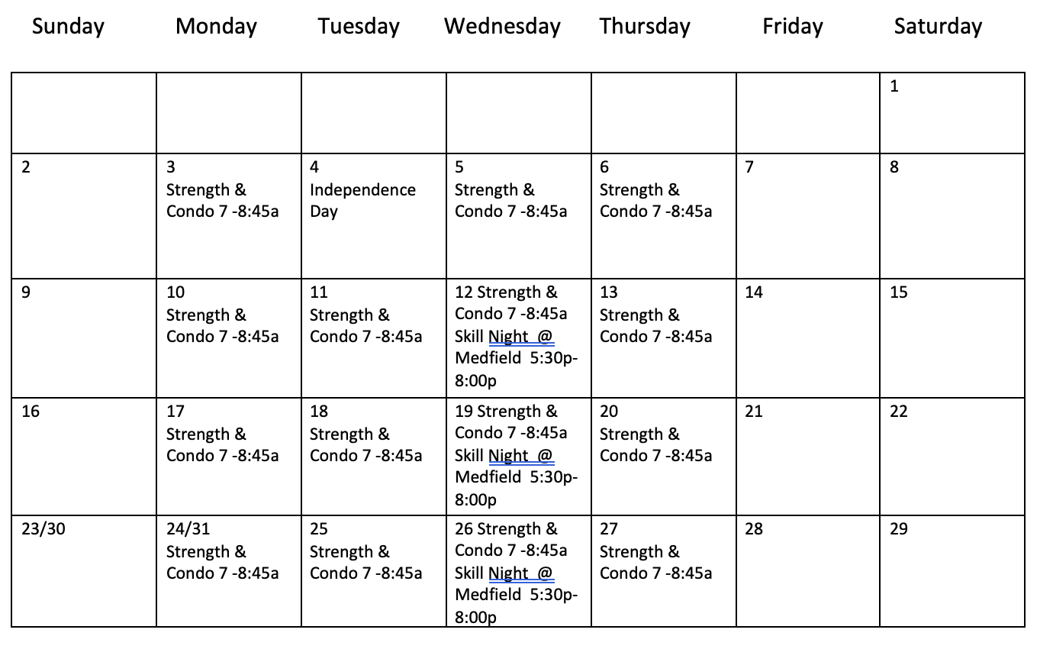
JULY 2023

Slide 6
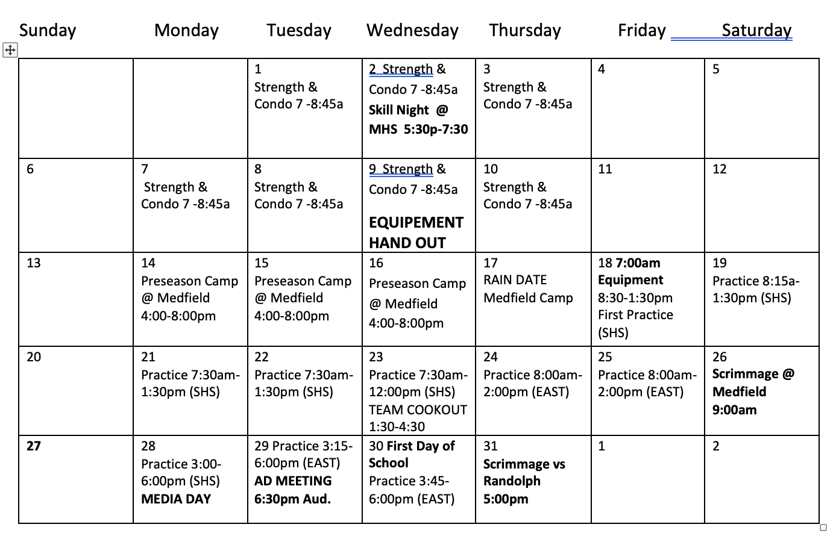
August 2023

Slide 7
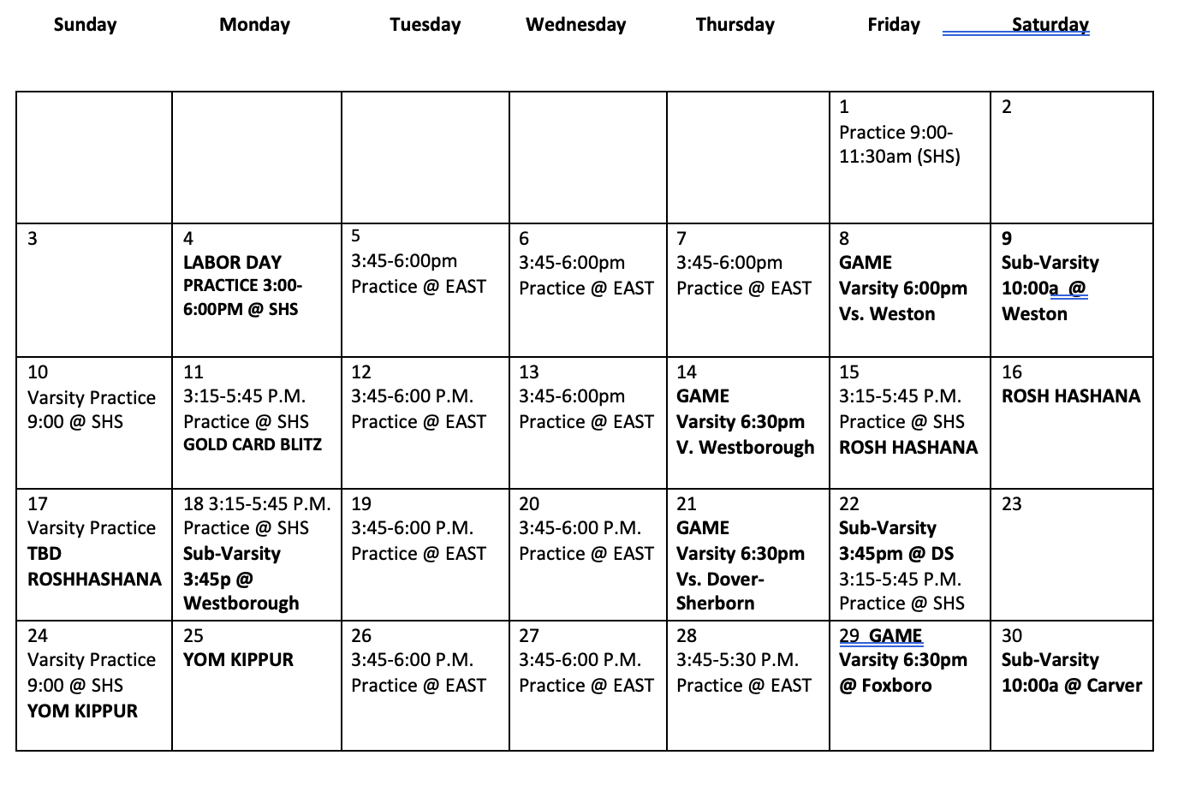
September 2023

Slide 8
FamilyID.com
Click “Find Program”
Search “Sharon High School”

Slide 9
Administrative Needs
Physicals
Dated no earlier than 7/18/22
Must remain within 13 moths for entire season.
Hand in to Coach Morse
Returning players will be on file.
User Fee
$375
Due between 7/1-9/8
Hand in to Athletic Director
Hardships

Slide 10
Equipment Needs
PROVIDED BY SHS
Helmet
Shoulder Pads
Thigh/Knee Pads
Practice Jersey/Pants
Game Jersey/Pants
Mouthpiece
PROVIDED BY PLAYER
Girdle
Gloves
Cleats

Slide 11
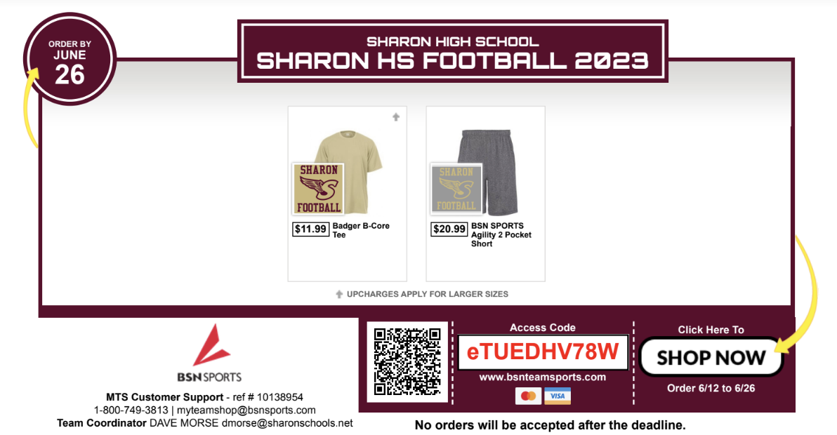
Online Store Links
Spirit Packs (MANDATORY)
https://bsnteamsports.com/shop/eTUEDHV78W
Equipment (Optional)
Cleats, girdles, gloves, socks
https://bsnteamsports.com/shop/krYF1yeXxM

Slide 12
Communications
Website:
Sharoneaglesfootball.com
Schedules, Paperwork, Pictures
Twitter
@SHSEAGLESFB
Email
dmorse@sharonschools.net
Remind App
Direct Coach to Player Communication
Team Parents
Seniors- Meghan Conway
Juniors- Angela Letendre & Lori O’Neill
Sophomores- Wendy Harsfield & Trisha Lee
Freshman- Jocelyn Carmody & Kathy Salkin

Slide 13
To Do List:
FamilyID.com
Spirit Pack Link (Ends 6/26)
Medfield Summer Clinic Waiver
Medfield Pre-Season Camp Sign Up (Coming Soon)
Physical Form
Player Apps/Sites
HUDL
Send me non-school email address
REMIND
Send me phone number
PLT4M
Download app and use Join Code “Sharon Eagles”

Slide 14
Fundraisers
Golf Tournament
August 14th @ Cape Club Sharon
9:00am Shotgun Start
$150 a golfer
$100 hole sponsorship
Gold Cards
Blitz Day 9/12 at 6:00pm
Need parent driving volunteers
Players are broke into groups and get specific streets in Sharon to sell.

Slide 15
What we buy….
Spring 7 v 7
Medfield Summer Clinic
Helmets
Jerseys
Shoulder Pads

Slide 16
Academic Support
Every school day at 7:15am
Room TBD
May become mandatory
Long-term planning, projects, group work, etc.
School supplies

Slide 17
PLAYING TIME
FACTS:
Players are always being evaluated.
Weight room, Locker room, practice field, film room.
Practice should be filled with competition.
Practices are open to the public.
Coaches decide playing time based on what gives the TEAM the best chance to win.
Best 11 play.
A second stringer must perform at or above the level of a 1st stringer to earn Varsity time.
The best way to make an impression on a coach is with incredible effort on scout teams, special teams, and in practice.
Playing time grievances:
1. Player will meet with position coach.
2. Player will meet with position coach and head coach.
3. Abide the ‘24 hour rule’
What NOT to do:
“My son doesn’t know I’m writing this email”
Try to discuss playing time before your player meets with Coach Morse.

Slide 18
Key Dates
6/15 Last School Day
6/20 Summer Condo (7-8:45am)
7/12 Medfield Skills Night (6-7:30pm)
8/10 Equipment Hand Out
8/14-8/16 Preseason Camp @ Medfield
8/18 First Official Practice (7:00am-1:30pm)
8/26 Scrimmage AWAY 9:00am
8/29 Media Day
8/30 Mandatory Parent Meeting 6:30pm SHS Aud.
8/31 Scrimmage HOME 5:00pm
9/8 First Varsity Game
9/12 Gold Card Blitz

Slide 19
GAME SCHEDULES
VARSITY
SUB-VARSITY
9/8 v. Weston 6:00pm
9/14 v. Westborough 6:30pm
9/20 v. Dover-Sherborn 6:30pm
9/29 v. Foxboro
10/5 v. Mansfield
10/13 @ Hudson 6:30pm
10/19 @ Stoughton 6:00pm
10/26 @ Canton 7:00pm
TBD
TBD
11/23 @ Oliver Ames 10:00am
9/9 @ Weston 10:00am
9/18 @ Westborough 3:45pm
9/22 @ Dover-Sherborn 3:45pm
9/30 @ Carver 10:00am
10/4 Upper Cape Tech 6:30pm
10/12 Hudson 4:00pm
10/21 Stoughton 9:00am
11/2 @ Upper Cape Tech 4:00p
11/6 @ E.Bridgewater 4:30p
Week 10 @ OA TBD

Slide 20
QUESTIONS?

